Slide 1
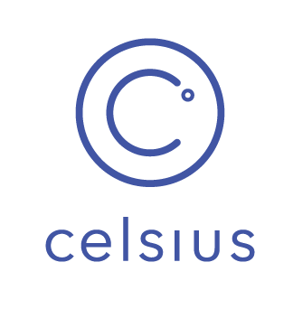
Celsius Network
A Cursory Look

Slide 2
Overview and Origin
Summer of 2017, Alex Mashinsky & Daniel Leon’s idea:
Democratize financial services
Using blockchain
Banking model:
Earn interest on crypto assets
Borrow loans using crypto assets as collateral
Mar 2018, ICO successful raising USD 50mm
Jun 2018, Celsius app v1.0.0 was launched
Latest Press Release: USD 300mm AUM and USD 2bn loan origination

Slide 3
Business Activities
Deposits are traded in various crypto exchanges, hedge funds
Under custody of BitGo
Protected by Lender’s Insurance Pool
Loans are issued based on deposits as collateral vs credit score
CEL token are issued to incentivize membership with access to more attractive rates
Celpay offers fee-less crypto payments
Integration of corporate partners

Slide 4
Landscape
Multiple Domains: Personal Finance, Lending, Blockchain, Cryptocurrency, Open Banking, Payments
Primary Domain: P2P Lending on the Blockchain
P2P Lending Growth: of USD 898bn by 2024
Primary Competition: SALTLending, ETHLend, NEXO
Primary Advantage: Trusted 3rd party Custodian and CEO - backer of VoIP

Slide 5
Results
In just 2 years of operations:
2,165 % growth in AUM
USD 300mm AUM
USD 2bn loans issued
40K members
160+ countries
Milestones that no other fiat P2P lending companies or traditional banks has achieved.

Slide 6
Emerging Concern & Recommendation
Deposit Protection:
BitGo Minting Process
Lender’s Insurance Pool
Exposure from partnership with margin trading exchange Bitfinex
Risk: legal and regulatory investigations of Bitfinex
Recommend to offer insurance similar to FDIC insurance
Already being offered by SALT
Leverage blockchain technology
Potential revenue generating product

